Slide 1
MCFN Post-Secondary Education
On-line application instructions 2024

Slide 2
First time applying for funding?
Go to https://mncfn.ca/
Look for Departments, then go down to Post-Secondary
Click on this link for the application (online)
https://mcfn.dadavan.com/student/pseapplication.jsp

Slide 3
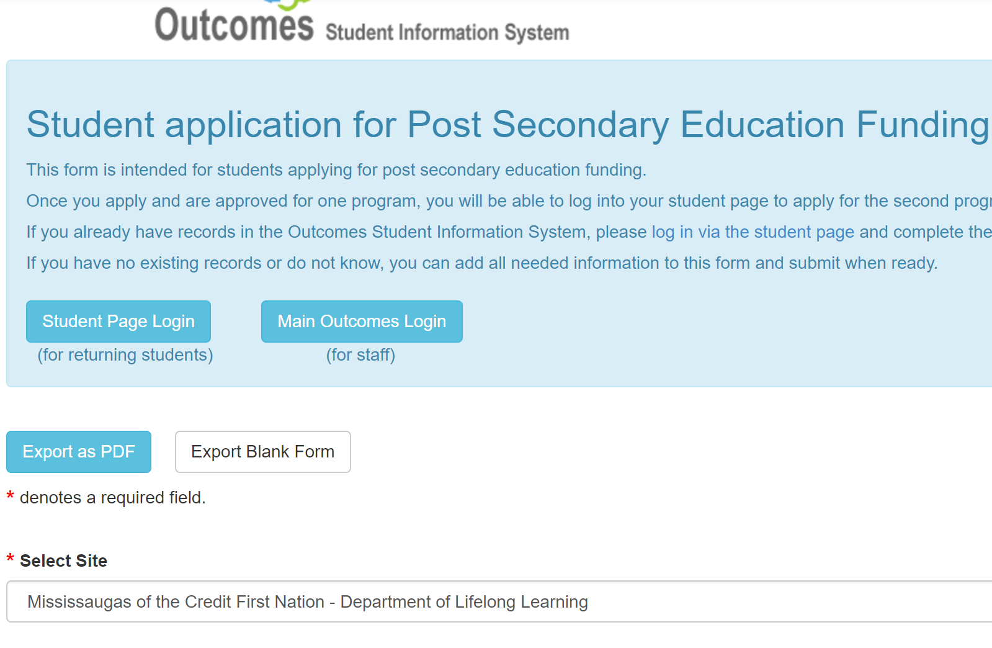

Slide 4
After making sure you are applying on the right site, go down that page, answering every box that has a red star, then Submit
Did you notice the three documents that said to download? They will be needed to complete the application. You can find them later on the website or in the Student Portal (required) documents
Meanwhile, did it refuse to submit? Did you ever apply for Post secondary funding? Maybe you need to go to the next page

Slide 6
MCFN Post-Secondary Education
Once your status number is in the system, you will not be able to apply that way.
Instead, click on the Returning student button, and enter your email as the Username.
Then click on the button to retrieve password, and check your junk mail for the new password.

Slide 7
To complete the online application, you will need the name of the school you are applying to, so if that is all you lack-apply. We can change the name of the school if you change your mind, but we cannot change your application date to give you a higher priority.
The Academic year defined by Indigenous Services Canada starts in May of the current year, and ends April of the following year. Your application can span the academic year.

Slide 8
The application goes into Pending until reviewed.
When the application is reviewed, you will receive an email telling you to complete the application.
The application is not eligible for funding until it is complete.

Slide 9
Yearly requirements:
Application Declaration
Financial Contract
Release of information
Previous Transcript
Upload with first application, only replace when changed or updated:
Status card
Direct deposit or void check

Slide 10
Where can you find those documents? 3 Places
They are available as three separate downloads on the original application (you can download them from there anytime)
They can be found on the Post Secondary page, as the Application Declaration
You can log into your account on Dadavan, Student Outcomes and go to Documents- they are in the Required Documents under the Student Portal

Slide 11
FAQ’s
Yes, you need to upload your transcript at the end of each semester, asap (failure to do so could put your Living Allowance on Hold)
Your new schedule needs to be uploaded before the next semester starts.
Yes, you have to apply each academic year you want funding support (ISC requirement)

Slide 12
FAQ’s
How will you know you are being funded?
You will receive an Eligibility letter, and be copied on the sponsorship letter sent to the school on your application.
When will you get money?
Expect deposit on the 1st day of the month starting the term. Book money is deposited once each term. (save your receipt if books cost more, we can reimburse)

Slide 13
FAQ’s
What if you choose Residence over Living Allowance?
You must apply to Residence yourself. The money is the same-$6000 per term, and you will be copied on the sponsorship letter to Residence. Any shortfall in costs you will need to pay.
Any money remaining up to the $6,000 will be deposited into your account at the end of a successful semester.

Slide 14
FAQ’s
What if you live over 800 kms. from your school?
You need to price several ways to travel economically, then tell us which you prefer and why.
What if I have extra or special course requirements?
Let us know as soon as you can! Send us an email with details and timeline.

Slide 15
FAQ’s
All these questions can be answered by reading the Policy, found on the Post Secondary Resource page.
Please read the Policy, paying special attention to the Student Responsibilities.
Help us support you, by remaining in good standing and communicating with the Post Secondary Advisor (Bernadette, LLPSA@MNCFN.CA)

